Slide 1

MOOC (Massive Open Online Learning):
the New Way of Learning
Presented by
Lucyanna M. Pandjaitan
President Director & CEO IndonesiaX

Slide 2

www.indonesiax.co.id

Slide 3
INDONESIAX
IndonesiaX is an e-learning platform, reminiscent of edX, a university-level Massive Open Online Course (MOOC) platform that was spearheaded by the Massachusetts Institute of Technology (MIT) and Harvard University in 2012
Anybody, anywhere in Indonesia and/or abroad at any time convenient to him or her can learn from the best instructors from the best universities and companies in Indonesia and/or abroad for free to increase their knowledge and life skills, just by a touch of a button

Slide 4
VISION AND MISSION
VISION
To be the most preferred independent online MOOC/SPOC hosting platform which enriches lives of Indonesians.
To provide a state-of-the-art, sustainable, and affordable online MOOC/SPOC hosting platform that offers free high quality online MOOCs/SPOCs provided by the best local and foreign universities, government agencies, companies and other respected institutions.
To help democratize education and improve life-skills of Indonesians spread out in Indonesian archipelago.
MISSION

Slide 5
WHY MOOC FOR INDONESIA
Challenges
Need for economic growth
Need to create job opportunities (entrepreneurs)
Need to be globally competitive (competition from neighboring countries)
Limited access to high education and training in general (spread out in 17,000 islands and 34 provinces)
Quantity and quality of human capital
Teacher training (school, TVET and higher education)
Skills/competency and aptitude
Opportunities
Rapid changes in ITE
Indonesia is one of the countries with highest internet users (69 million cellular phone users in 2016, compared to 27 million in 2013)
Demographic bonus in 2025 to 2035 (number of people within the productive age bracket is higher than the number of elderly people and children)

Slide 6
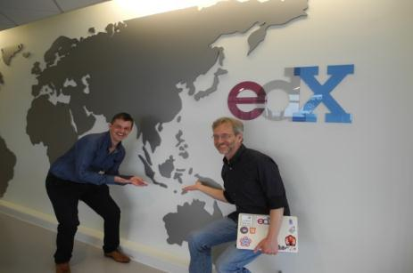
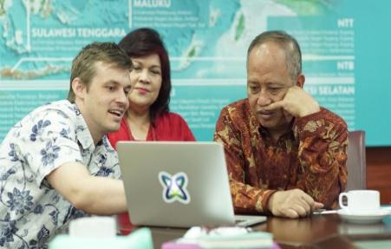
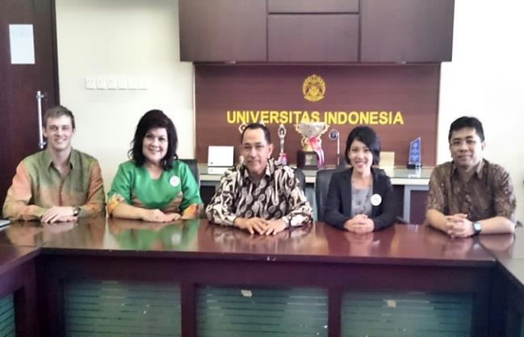
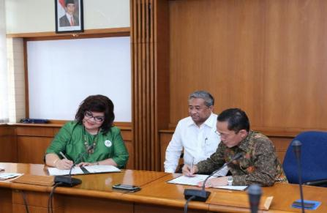
HOW WE EVOLVE
With the Minister of Research, Technology and Higher Education Indonesia, Mr. Muhammad Nasir
Visit to edX
With Minister Muhammad Nasir
Meeting with University
of Indonesia
MoU Signing ceremony with ITB

Slide 7
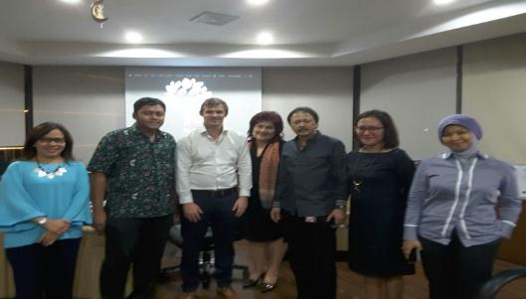
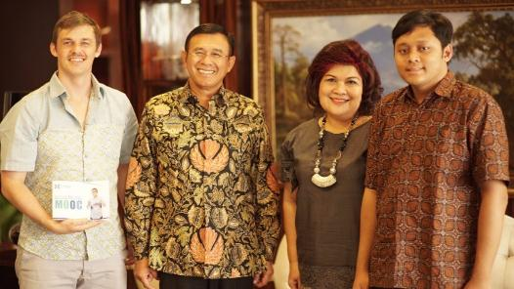
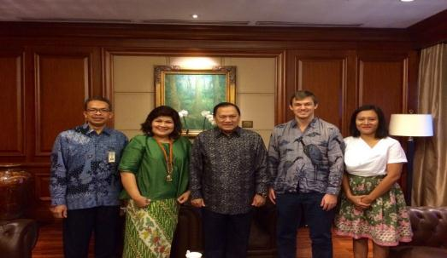
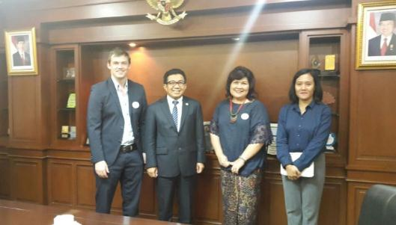
HOW WE EVOLVE
With the President Director of Indonesia Stock Exchange, Mr. Tito S
With the President Director of BNI,
Mr. Achmad Baiquni
With Governor of Bank Indonesia, Mr. Agus D.W. Martowardojo
With the Chairman of Indonesia Financial Services Authority , Mr. Muliaman Hadad

Slide 8

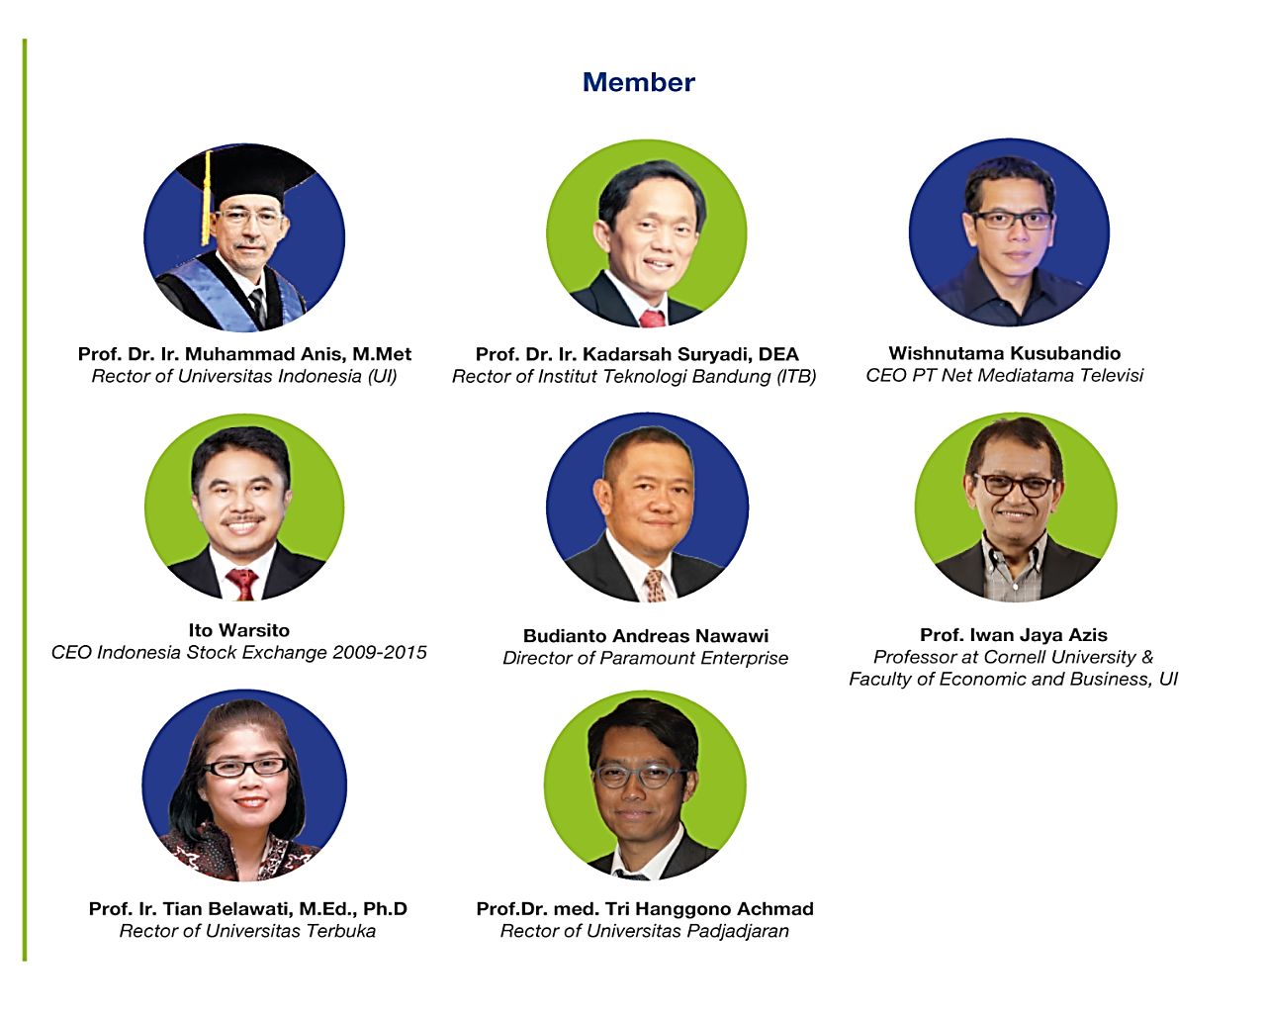
OUR ADVISORY COUNCIL

Slide 9
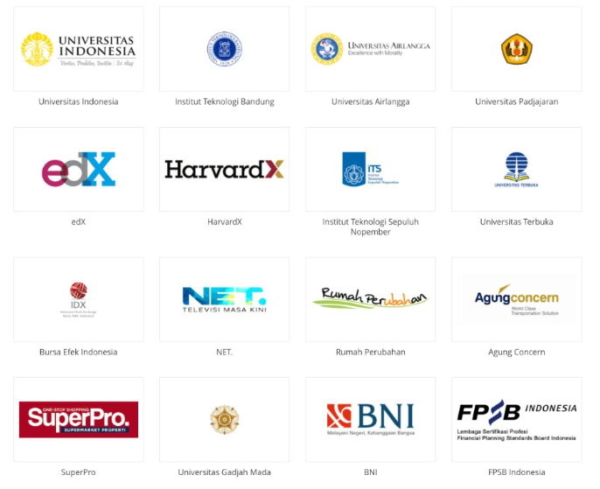
OUR PARTNERS

Slide 10
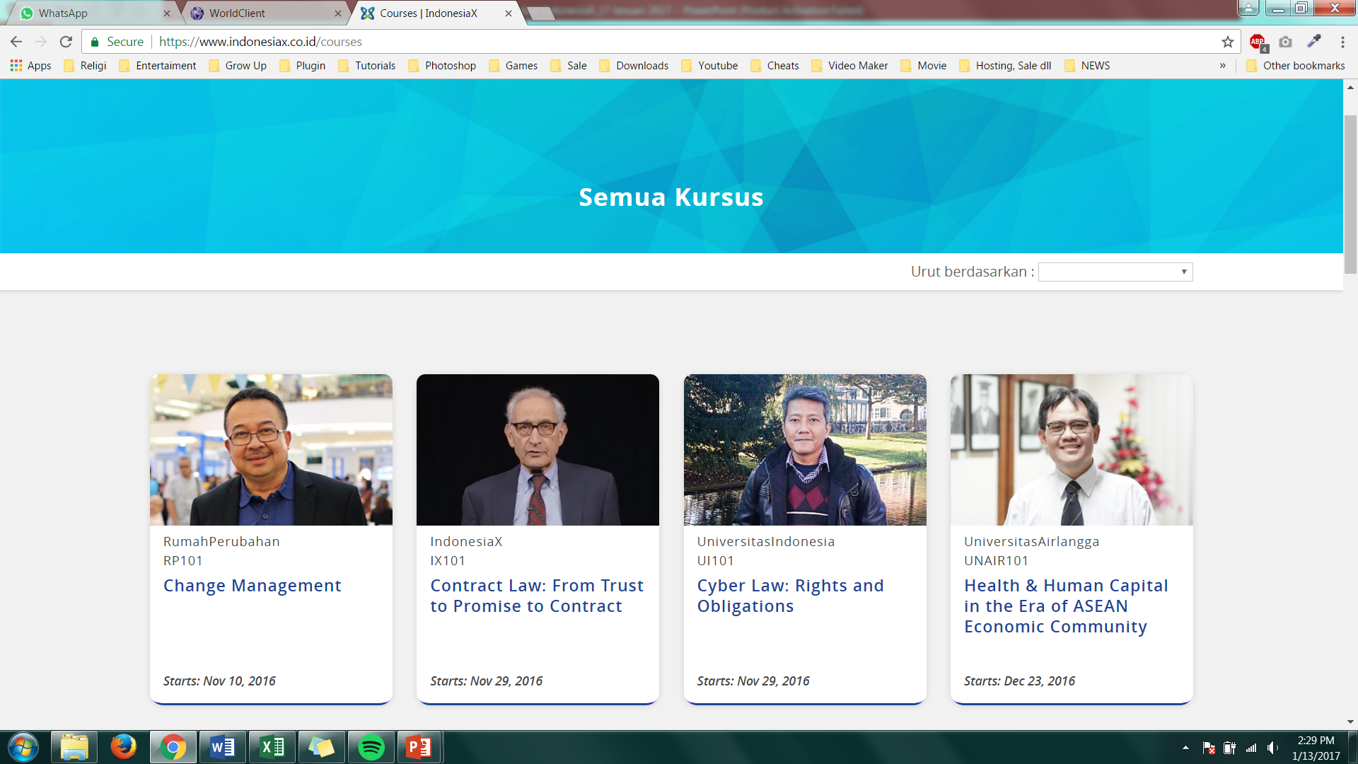
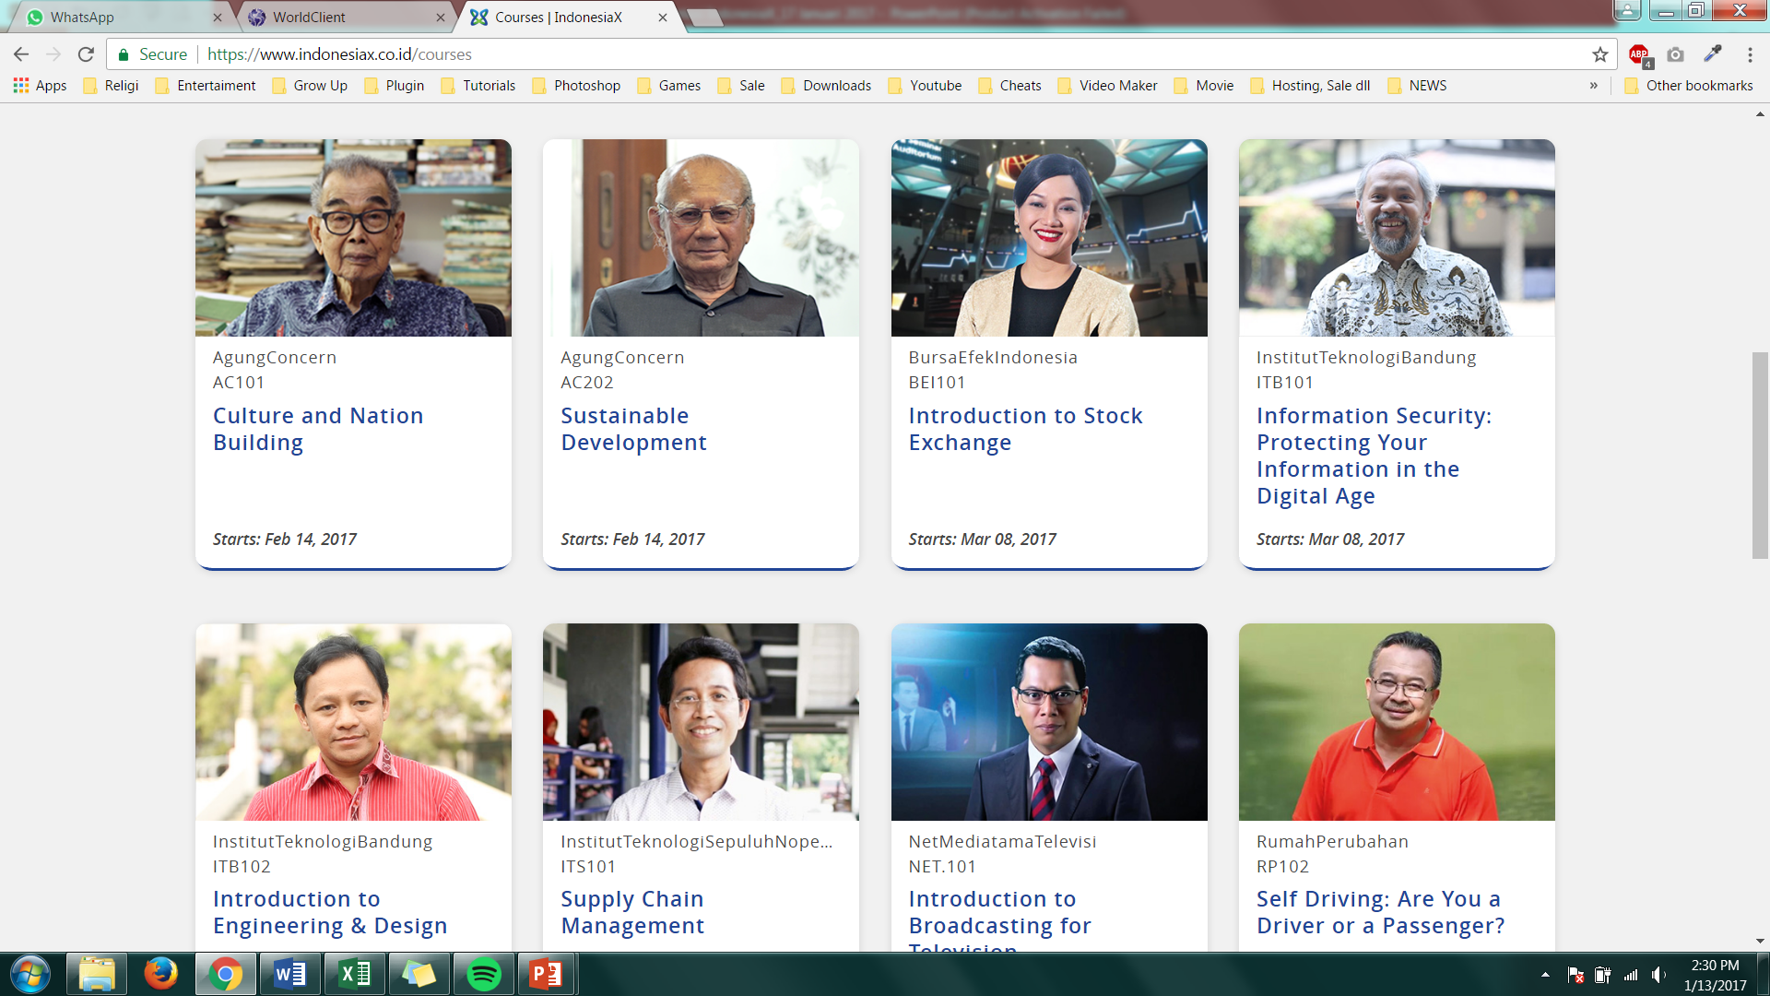
OUR COURSES
We aim for 30% Academic and 70% Life Skills
First Launch: Aug 17, 2015
First Launch: May 2, 2016
First Launch: Aug 17, 2015
First Launch: Aug 17, 2016
To be Launched: Feb 14, 2017
To be Launched: Feb 14, 2017
First Launch: Aug 17, 2015
First Launch: Feb 14, 2016

Slide 11
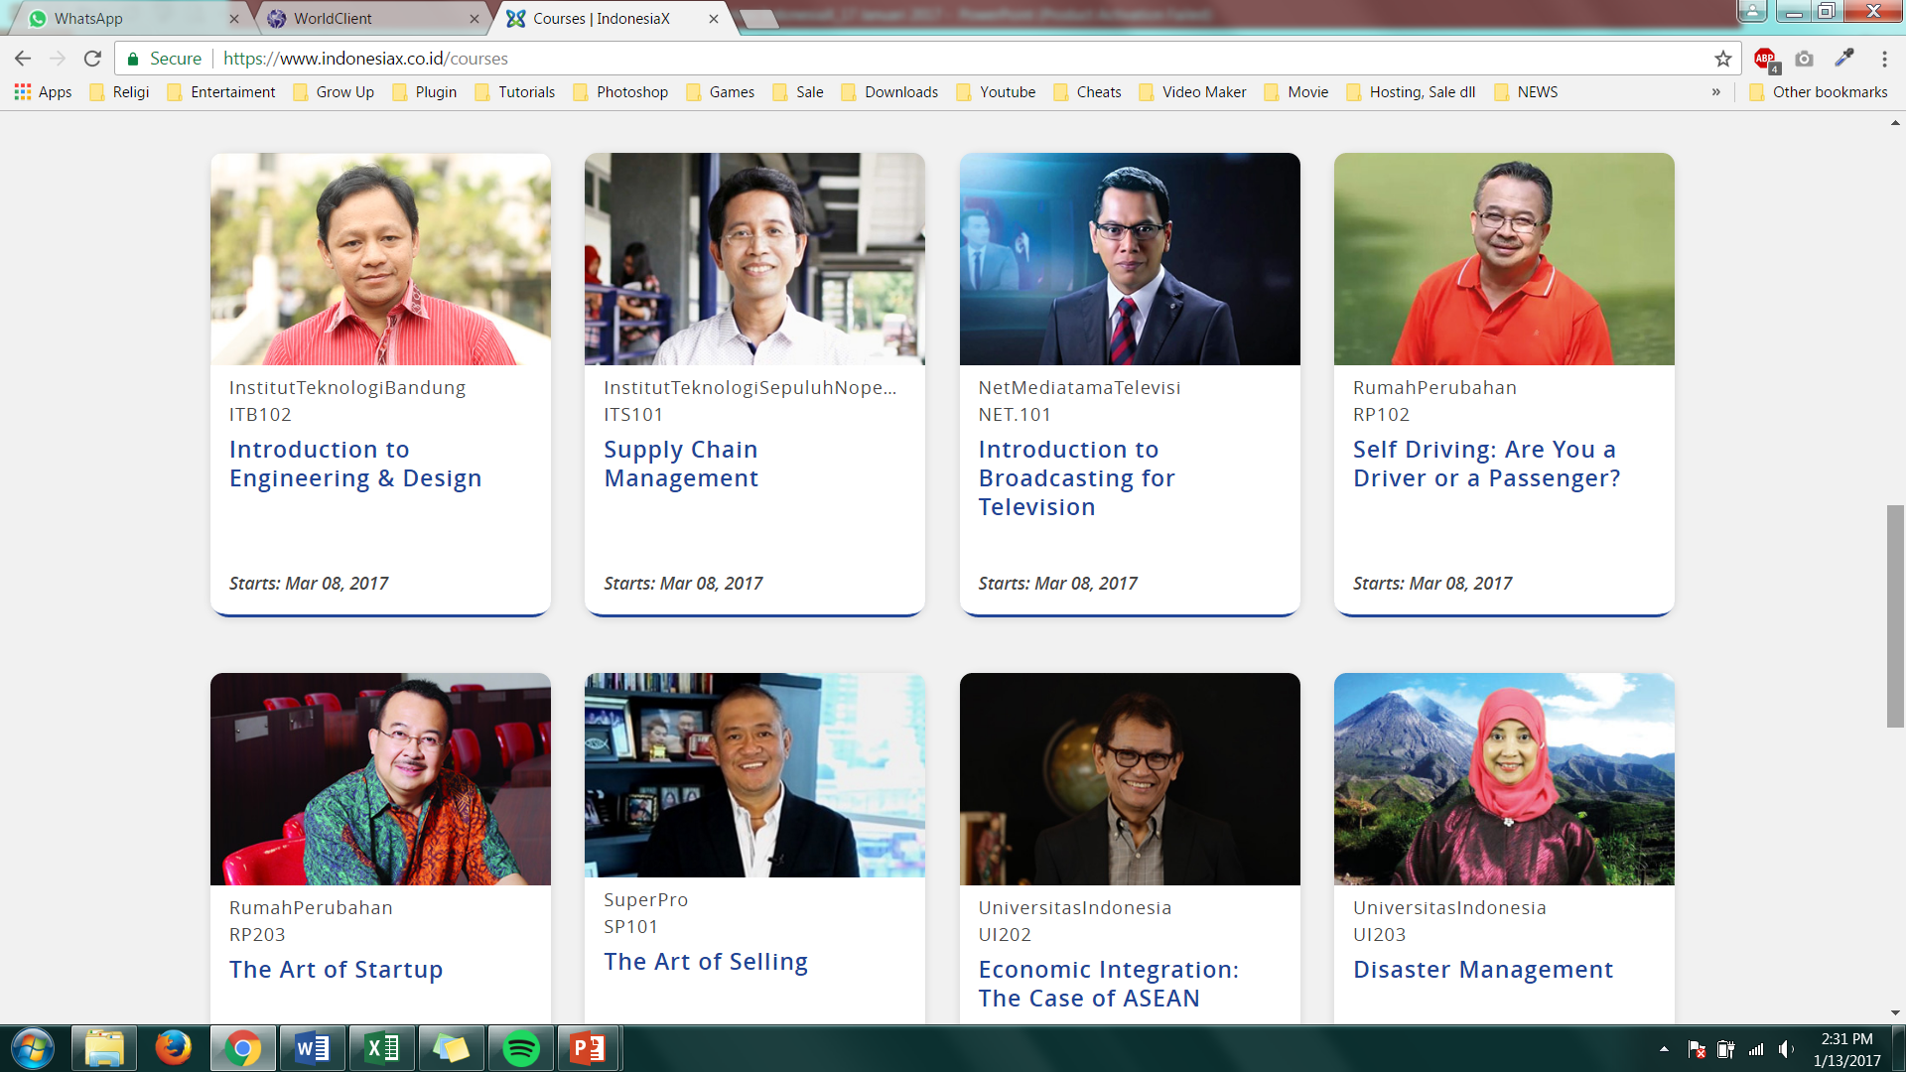
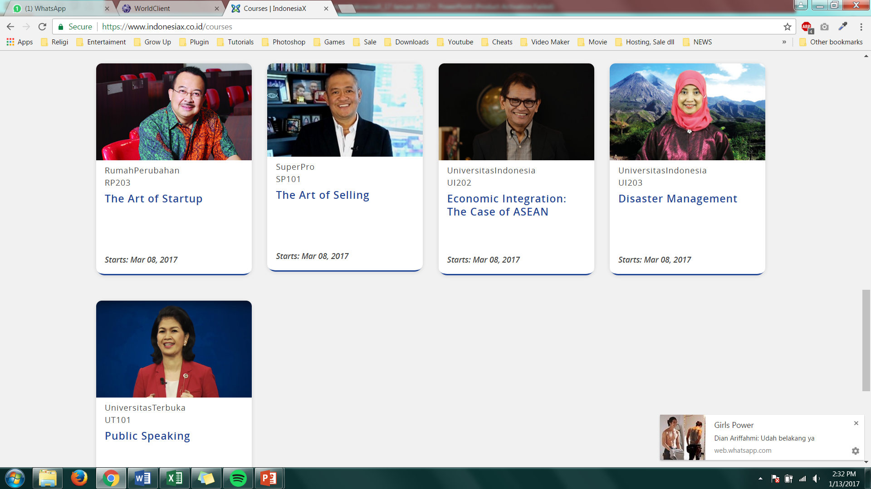
OUR COURSES
We aim for 30% Academic and 70% Life Skills
First Launch: Mar 14, 2016
First Launch: May 2, 2016
First Launch: Dec 1, 2015
First Launch: Dec 22, 2015
First Launch: Aug 17, 2016
First Launch: Nov 10, 2016
First Launch: Feb 14, 2016
First Launch: Nov 10, 2016

Slide 12
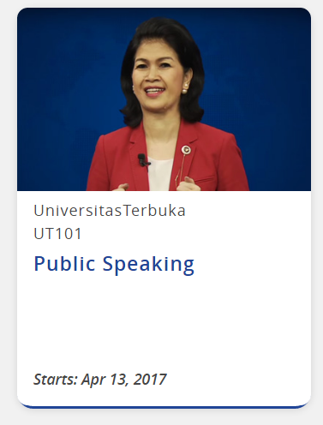
OUR COURSES
We aim for 30% Academic and 70% Life Skills
Upcoming Courses to be Launched:
UI 204 - Economic Development
UI 205 - Micro-Finance
UNPAD 101 - Children’s Allergy
BNI 101 - Introduction to Banking
First Launch: Feb 14, 2016

Slide 13
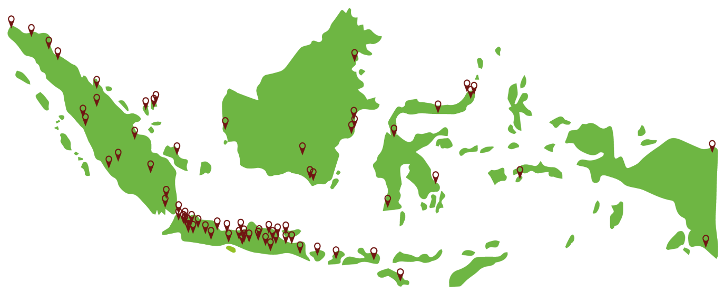
WHERE WE ARE NOW - INDONESIA
as per May 2, 2017
Top 5 Provinces
1. West Java 23,0%
2. East Java 14,4%
3. DKI Jakarta 12,8%
4. Banten 7,4%
5. Central Java 7,1%
Learners from Java 64,7%
Learners from other 35,3%
provinces in Indonesia

Slide 14
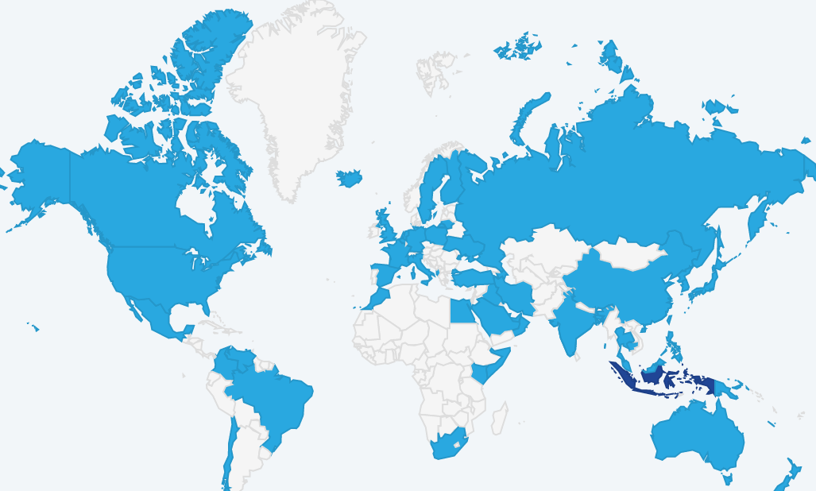
GLOBAL REACH
as per May 2, 2017
# Countries
75
# Course Registrants
104.614
# Cities
901
# of Page Views
5.342.577

Slide 15
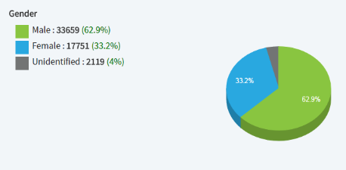
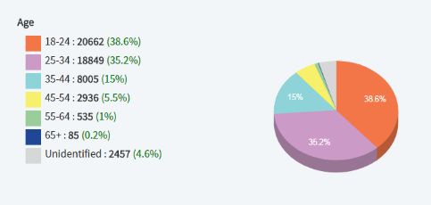
OUR LEARNERS
as per May 2, 2017
Ratio (certificates to learners) | 2015 | 2016 | 2017
 | 0.26% | 1.07% | 1.36%
Most learners are from 18-24 and 25-34 age bracket
More male learners than female ones
Ratio of certificates vs learners is on increasing trend

Slide 16
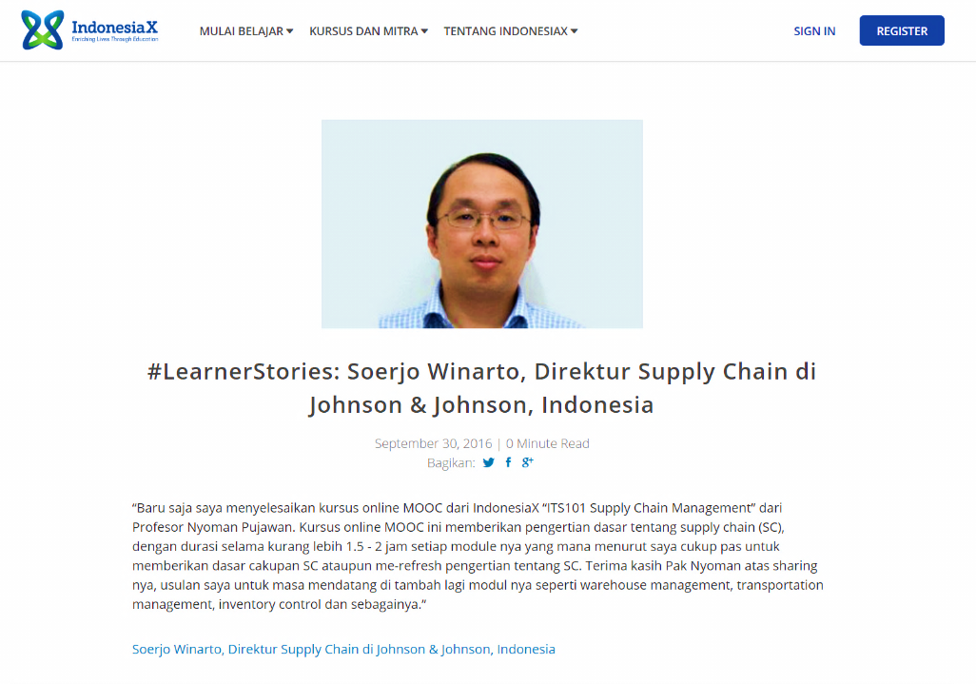
LEARNERS’ STORIES

Slide 17
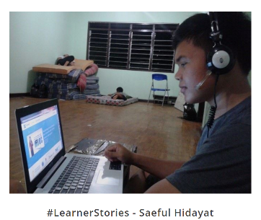
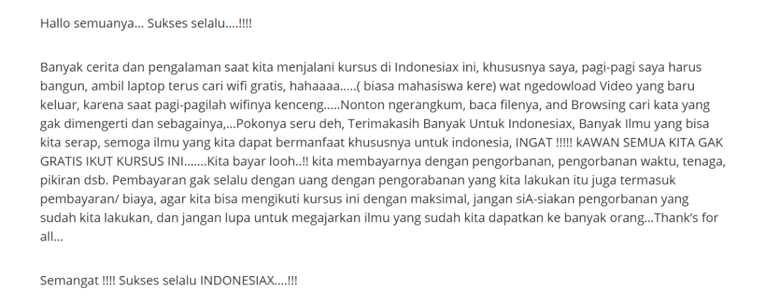
LEARNERS’ STORIES

Slide 18
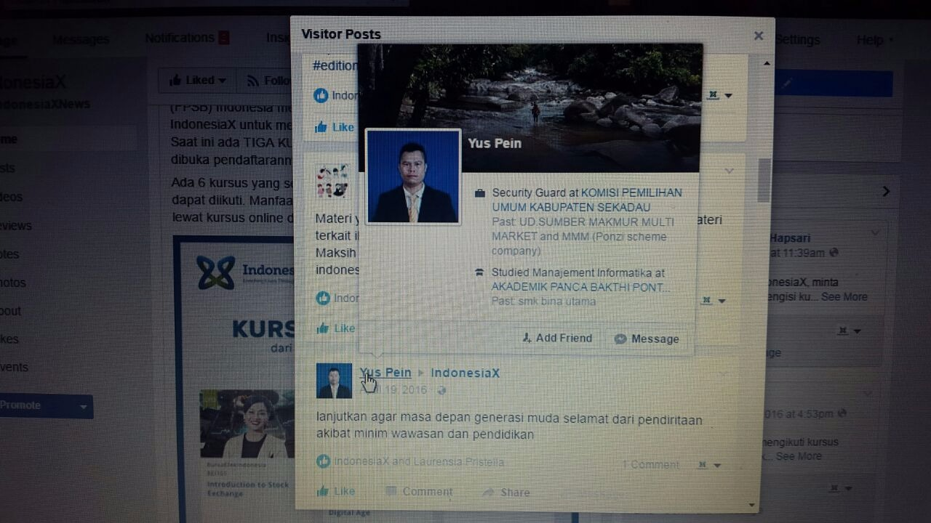
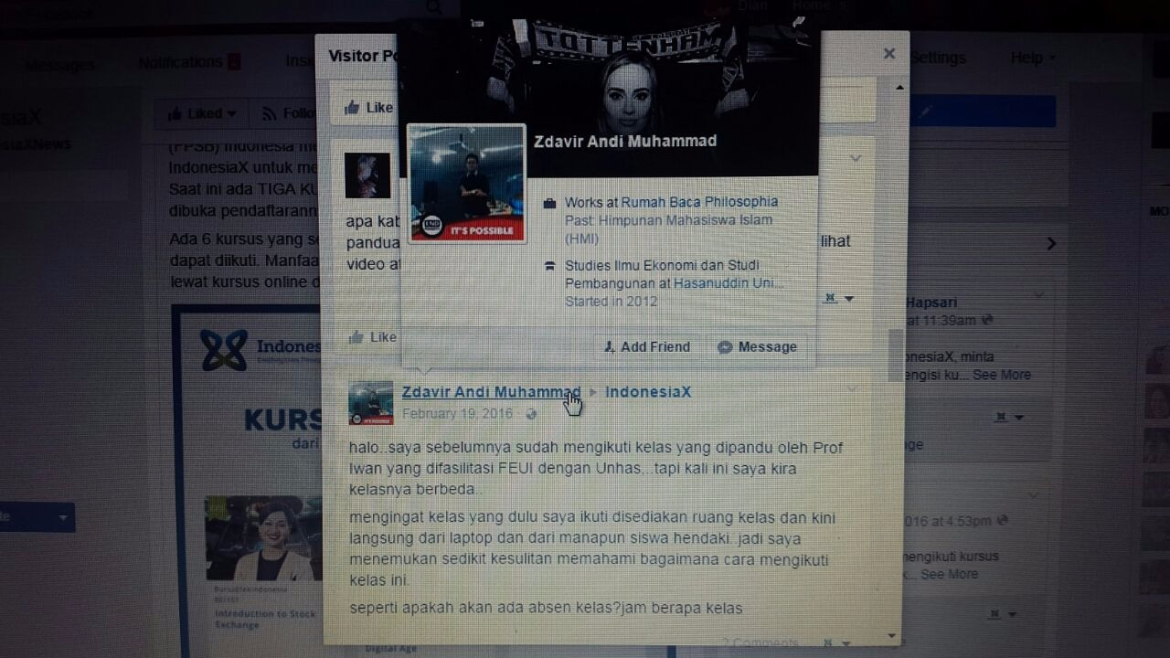
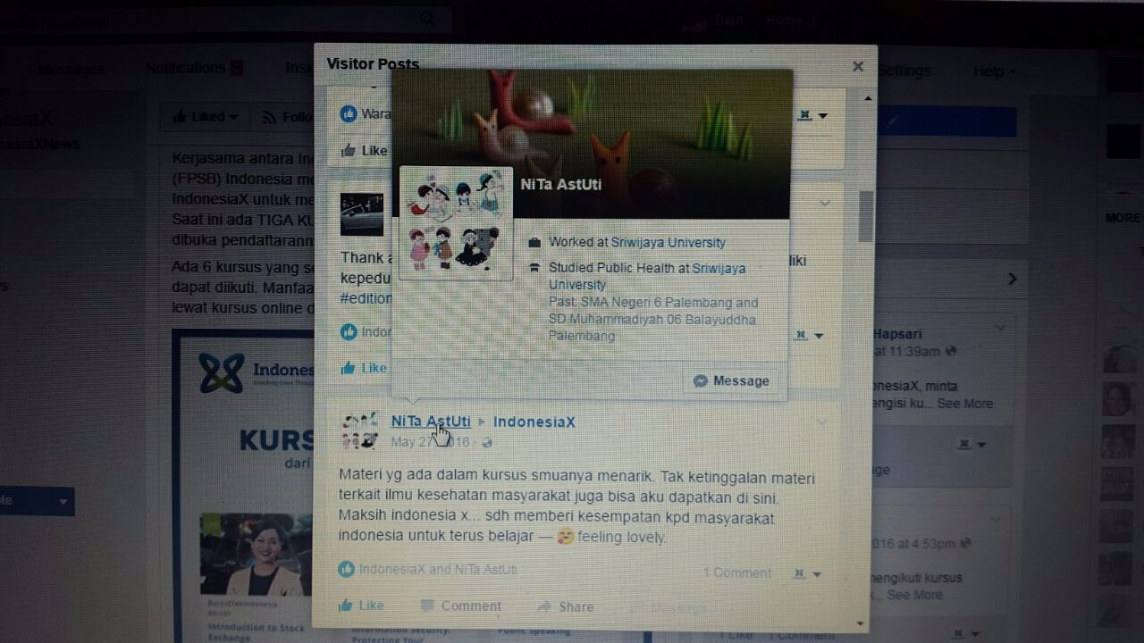
LEARNERS’ STORIES
Learner from Sekadau, Kalimantan
Learner from Makassar
Learner from Palembang

Slide 19
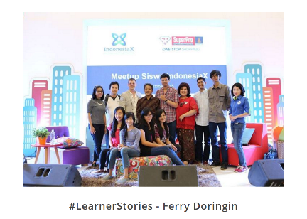
LESSONS LEARNED
Positive response from students
Positive response from universities
(both on MOOC existence as well
as in providing content)
Positive response from corporates (in providing content and in using the courses as training material)
Positive responses from government
Poor internet connection in provinces in East Indonesia and in some West too
Difficulty in getting funding

Slide 20
GOING FORWARD
Reach more cities/towns in Indonesia
Cooperation with telco companies and broadcast media to reach wider area coverage
Involvement of provincial governments in reaching learners
Collaboration with government agencies and NGOs
More MOOCS from companies/industries (HC requirement)
Training platform for corporates and financial institutions
Curriculum Development
More MOOCs from foreign universities on latest development
English translation
Accreditation
Sustainability (business model)

Slide 21
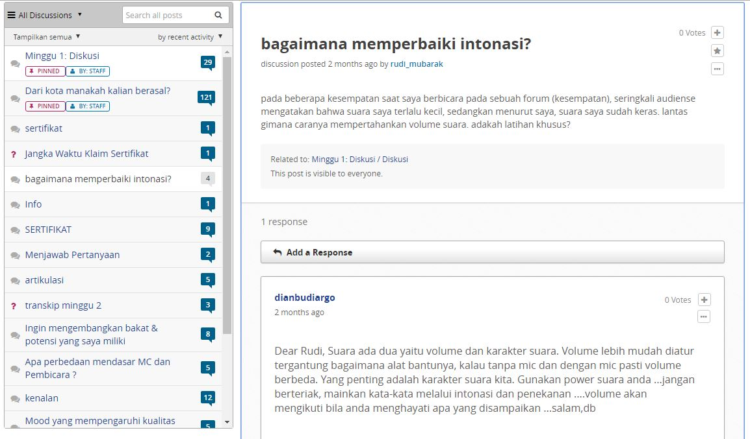
GET MORE ENGAGED WITH PARTNERS AND LEARNERS
(1) Discussion Forums

Slide 22
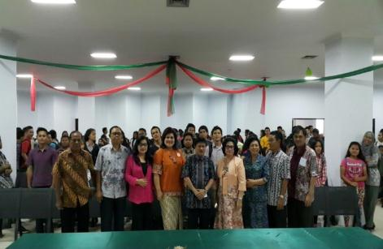
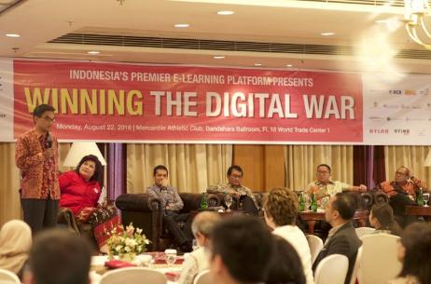
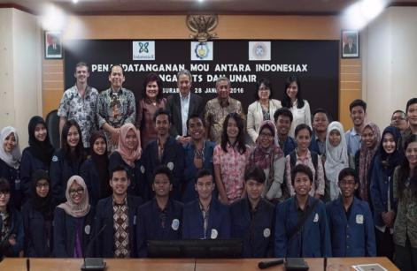
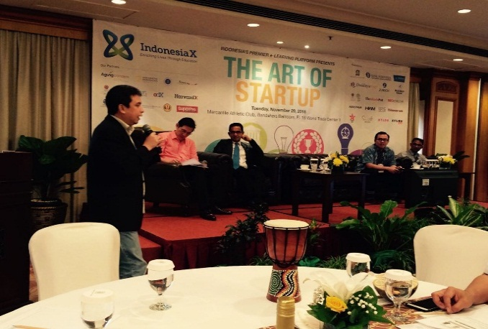
GET MORE ENGAGED WITH PARTNERS AND LEARNERS
(2) Meet Ups
(3) Seminar
Tondano,
19-11-15
Jakarta,
22-08-16
Surabaya,
28 -01-16
Jakarta,
29-11-16

Slide 23

GET MORE ENGAGED WITH PARTNERS AND LEARNERS
AND OF COURSE…..
OUR TODAY’S EVENT

Slide 24
THANK YOU
Please check us out
at www.indonesiax.co.id

Slide 25
HOW TO REGISTER

Slide 26
HOW TO REGISTER

Slide 27
HOW TO REGISTER

Slide 28
HOW TO REGISTER

Slide 29
HOW TO REGISTER

